Slide 1
CMSE 201 Project Proposal
Yashwanth Manne
Section 005

Slide 2
Original Ideas
Data: Evolution of the 3-Pointer in the NBA
I would use data from the NBA regular season games since the 2000s to understand how much more common 3-Pt shots have become in the NBA. I could also look to see if there a correlation between the pace (how many possessions per game) and the number of 3-pts attempted. I could create a scatter plot between number of possessions in a game and the number of 3-ptrs attempted per game. I could also create a scatter with the average seconds left on the shot clock when a 3ptr is attempted. I would need to become comfortable with pandas to be able to mine from a dataframe.
Model: PFAS in Ann Arbor
I could try looking over research reports, news articles, and a watershed map of Ann Arbor to try to create an computational model of PFAS spread through the Ann Arbor water shed and maybe see how many people in the greater A2 area would be affected by the PFAS in the next 5 years. This would require me to become quite comfortable with either ODEINT or ABM. Depending on the data I could find, I would then choose between the two.
Data: Spread of "Trump-ism"
An article in the New York Times talked about the effect that Trump's election has had on policies across the globe like Brexit in the UK and the election of Modi in India. After looking at election data and policy reform in various countries, I could categorize each policy or candidate on a liberal v conservative spectrum and isolationist v globalist spectrum and try to cross compare from one to another. I have no idea if I could even do this using Pandas.
Model: Drug Metabolism
I could research a well studied drug whose metabolism pathway has been clearly charted and try to model its plasma levels in patients using ODEINT. By looking at medical data, I could define the parameters to be the Kcat, Km, and [] of the enzymes involved in the pathway. If this drug were an opiod, I could try to see how a subtle shift in one parameter could cause the drug level to rise above the therapeutic window. I would need a lot of Biochem understanding and an even better understanding of ODEINT
Ask Dr. Hoogstraten to be pointed in the right direction. Use Kaggle as a database source.

Slide 3
Drug Metabolism

Slide 4
Motivations
Why do you want to study this project? What question(s) do you want to answer?
I want to study the modeling of drug metabolism since its connected with the topics covered in one of my classes. Additionally, I want to focus on the drug metabolism of opioids specifically since opioid overdoses have become a pressing issues in recent years. I hope to get an understanding about why opioid overdoses are so common and if the overdoses are resulting from a tight therapeutic window and whether population variation over enzyme kcats and Km can force the drug dose to raise above the therapeutic window.

Slide 5
Model/Computing Method
Briefly describe what model or computational method you plan to use for your project. [The class will cover more modeling material later; a rough sketch will do.]
I will try to model its plasma levels in patients using ODEINT. By looking at medical data, I could define the parameters to be the Kcat, Km, and [] of the enzymes involved in the pathway. If this drug were an opioid, I could try to see how a subtle shift in one parameter could cause the drug level to rise above the therapeutic window. I will have to create a compartmental model of the pathway first in order to define my differential equations.

Slide 6
Python Tools
What tools do you expect to use for data manipulation and visualization (plots)?
matplotlib.pyplot
Seaborn for making my plots look nice
Numpy for making calculations using the data.
ODEINT from scipy.integrate

Slide 7
Main Opioid: Oxycodone
Focus: Use a pharmacokinetic model to model the blood plasma levels of oxycodone as it is cleared by one through the P450 pathway. I hope to also visualize the impact of common P450 inhibitors and activators on the levels of oxycodone.
Phases of the Project:
Research:
Figure out which enzyme actually metabolizes oxycodone
Get a list of Inhibitors and activators of the enzyme
See if there are any alternative pathways for Oxycodone clearing
Coding
Draw a simple compartmental model showing the interactions between inhibitors, activators, and substrate of the P450 pathway.
Start off as a First-order reaction and then build up.

Slide 8
Time-permitting
Coding
Try to encompass the minor drug-clearing pathways of oxycodone into the code.
Mess around by changing the dosage levels and the enzyme activity by changing the concentration of active enzyme
Final Outcome of the Project: An Interactive ODEINT model with interactive parameters that shows the change of the plasma levels of oxycodone and the necessary clearing time.

Slide 9
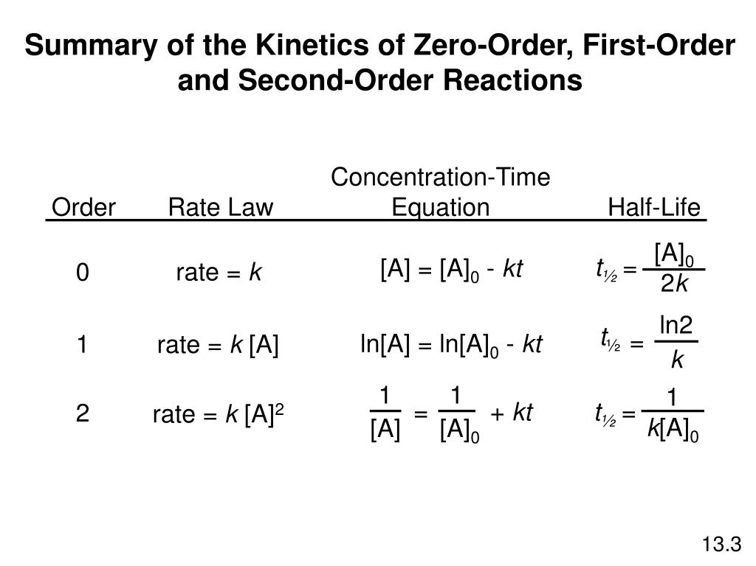
What I Have Done So Far: Research
Metabolized by CYP34A
Main parameter of interest is IC50 ~ Ki:
Equivalent to time of half-life
Can use the Half-Life equation to find k
Can use K to plot the concentration over time.

Slide 10
Research (Cont.)
Used PubMed to find relevant papers to see whether or not people have modeled opioids before:
Jennifer E. Sager, Jingjing Yu, Isabelle Ragueneau-Majlessi and Nina Isoherranen, Drug Metabolism and Disposition November 2015, 43 (11) 1823-1837; DOI: https://doi.org/10.1124/dmd.115.065920
Rostami‐Hodjegan, A. (2012), Physiologically Based Pharmacokinetics Joined With In Vitro–In Vivo Extrapolation of ADME: A Marriage Under the Arch of Systems Pharmacology. Clinical Pharmacology & Therapeutics, 92: 50-61. doi:10.1038/clpt.2012.65
"Voricanizole drastically increases exposure to Oral oxycodone"
"updated clinical pharmacokinetics and pharmacodynamics of oxycodone”
https://docs.boehringer-ingelheim.com/Prescribing%20Information/PIs/Roxane/Oxycodone%20HCl%20OS%205mg%20per%205mL%20Flavored/10009007%20Oxycodone%20HCl%20OS%205mgper5mL%20Flavored.pdf
A prescribing packet meant for doctors that details the IC50 values and shows some relevant sources.

Slide 11
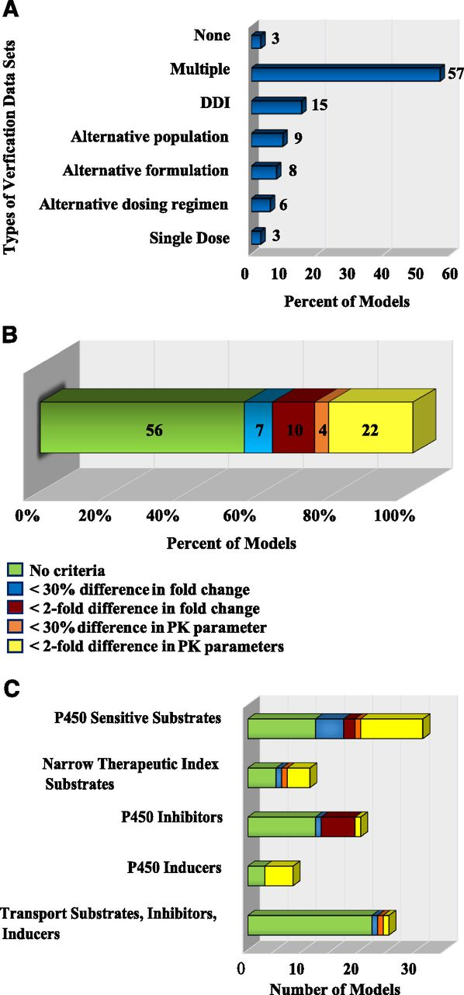
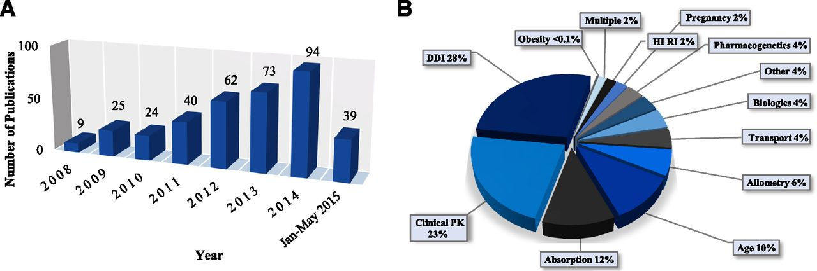
Current Pharmacokinetic Modeling Research
Jennifer E. Sager, Jingjing Yu, Isabelle Ragueneau-Majlessi and Nina Isoherranen
Drug Metabolism and Disposition November 2015, 43 (11) 1823-1837; DOI: https://doi.org/10.1124/dmd.115.065920

Slide 12
Pitfalls
Analysing and Understanding the the research
It’s taking a lot more time to do the research than I anticipated and so I have not started coding yet.
I hope to begin coding by 11/17
Finish 1st order model by 11/23

Slide 13
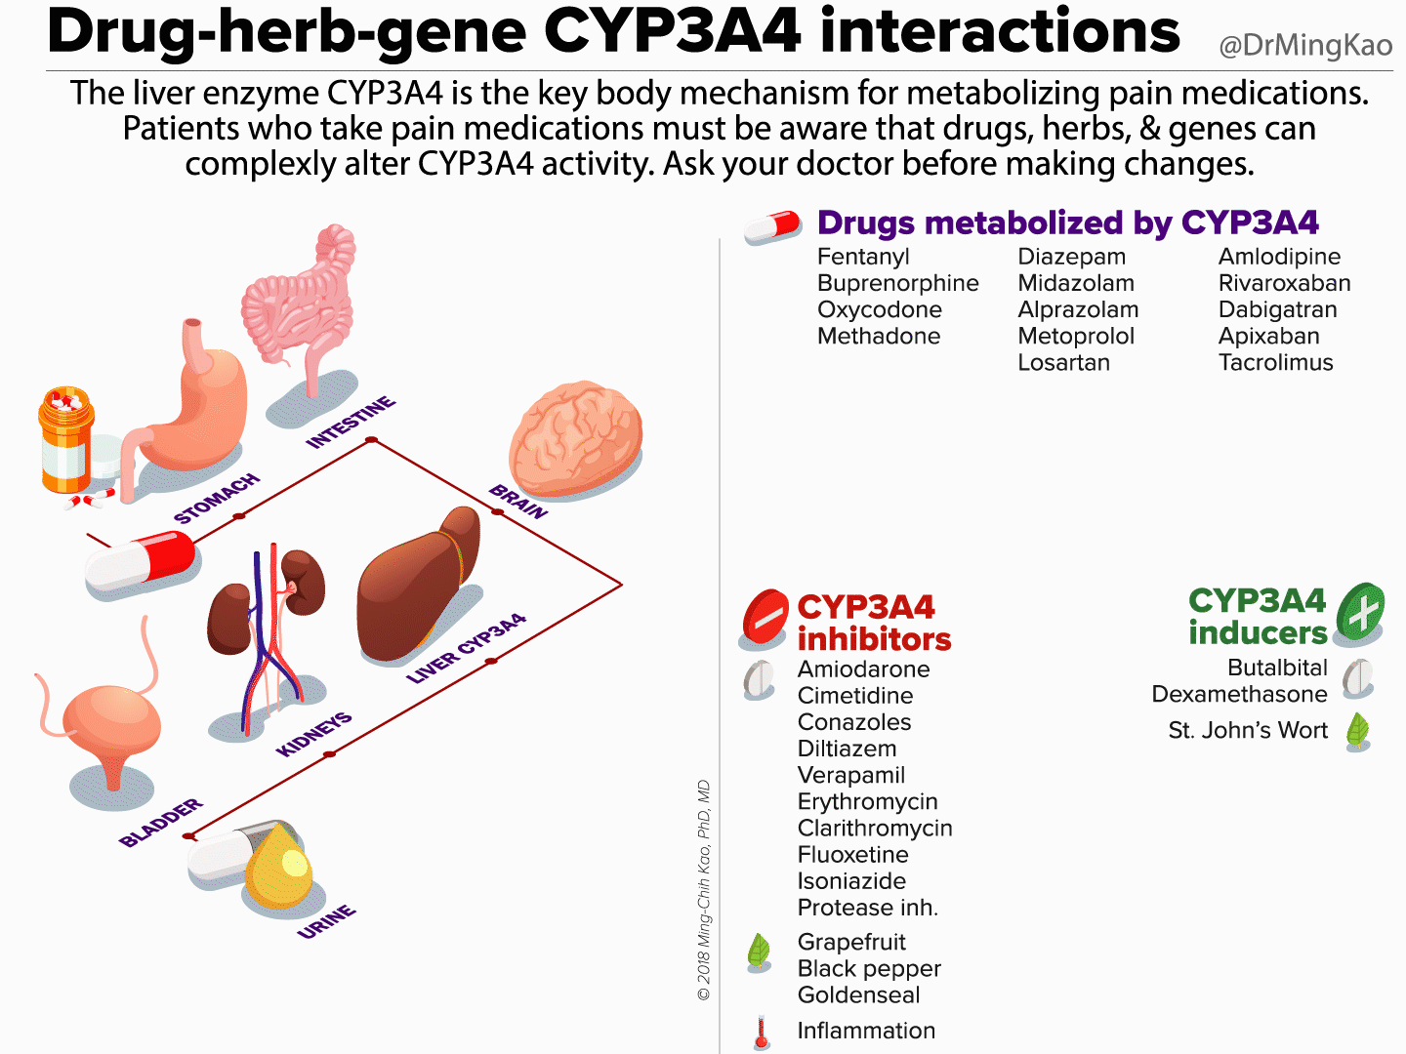
Main Inhibitors of the CYP34A

Slide 14
Important Things to Know
What is the P450 System?
Volume of Distribution (V, V_{d}):
A proportional factor that relates the
What is 3A4?
https://www.sciencedirect.com/topics/medicine-and-dentistry/cyp3a4
What is Oxycodone:
https://www.ncbi.nlm.nih.gov/pmc/articles/PMC4018705/pdf/aapm-01-262.pdf

Slide 15
Dosing Instructions
Start patients who have not been receiving opioid analgesics on Oxycodone Hydrochloride Oral Solution USP in a dosing range of 5 to 15 mg every 4 to 6 hours as needed for pain. Titrate the dose based upon the individual patient's response to their initial dose of Oxycodone Hydrochloride Oral Solution USP. Adjust the dose to an acceptable level of analgesia taking into account the improvement in pain intensity and the tolerability of the oxycodone by the patient.
In general, therapy can be decreased by 25% to 50% per day with careful monitoring for signs and symptoms of withdrawal

